Slide 1
Retrieval-Augmented Generation
Qing Wang, Ph.D., Nov. 30, 2023

Slide 2
Large Language Model (Generation)
LLMs don’t store facts – they store probability.
Notes:
Large language models they are everywhere now. this development is exciting the entire AI community including myself. These pre-trained neural language models have been shown to store ‘factual’ knowledge in their parameters.[1] that’s why these models become larger and larger. GPT4 has 1.7 trillions parameters, Llama II has 70 billions. they get something amazingly right and others are interestingly wrong. Why? LLMs don’t store facts – they store probability. Since it is a prediction, these models can have some undesirable behavior.

Slide 3

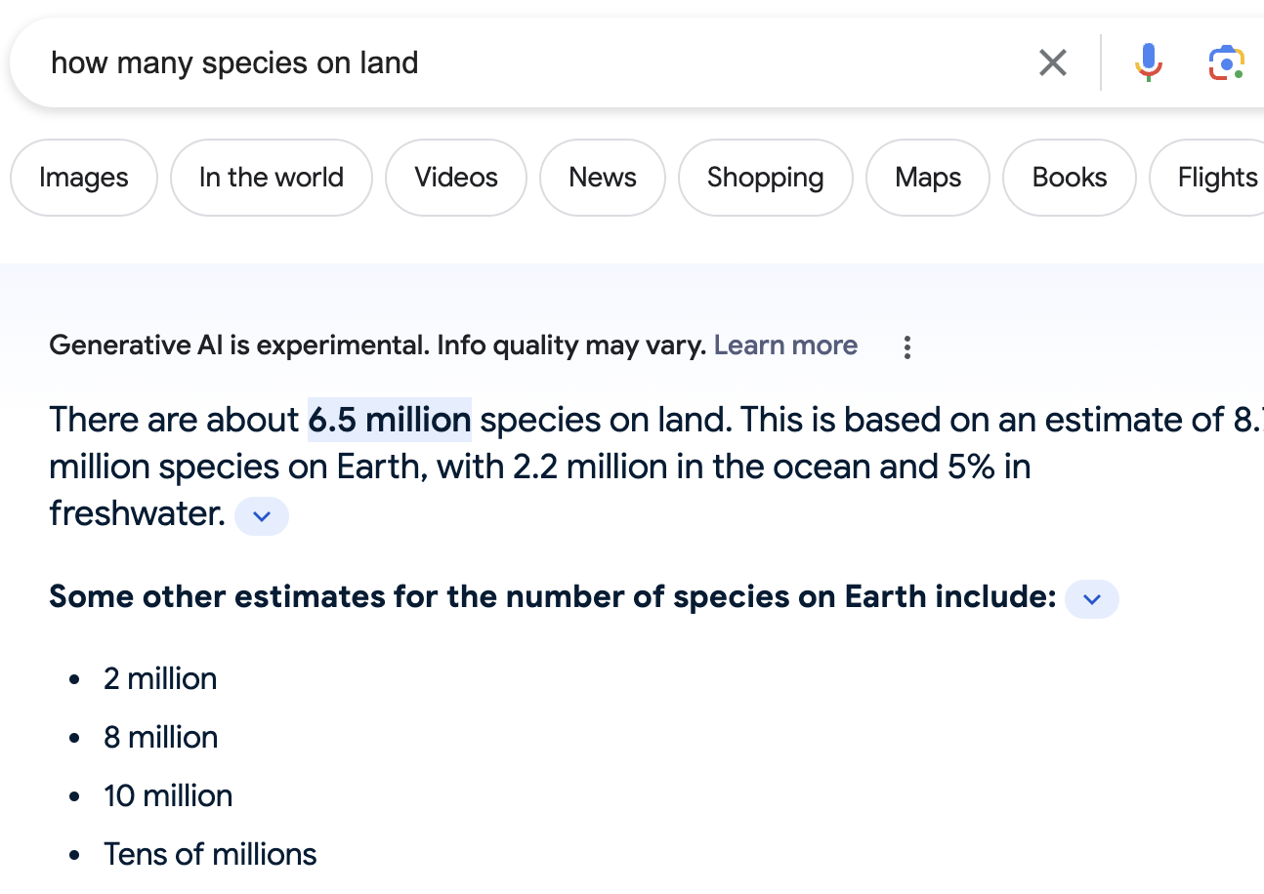
Large Language Model (Generation)
LLMs
user query = prompt
x: ”how many species on land”
y: generated text (extracting knowledge from parameters)
LLMs Challenges:
1. No source
2. Out of date
Generated text
Notes:
LLMs generate text in response to a user query, referred to as a prompt. For example, we ask a question about “how many species on land”. A large language model would confidently say: OK, I have been trained and from what I know in my parameters during my training, the answer is 6.5 million. The large language model is very confident about its answer, even if after 100 years, the answer would be the same if no new information is given to train this model.
These are LLM’s challenges: the first one is no source for the query and the second one is the answer is out of date.
So providing the right information is very powerful and it allows us to expand the knowledge of large language model by pulling in data from external resources which can be updated in real time.

Slide 4

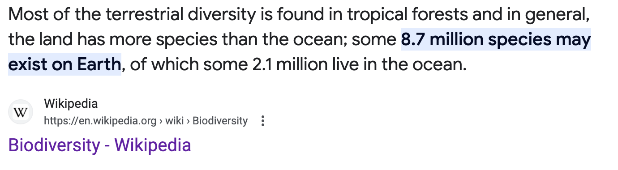
Retrieval-augmented Generation
LLM + RAG
x: ”how many species on land”
z: Wikipedia (be updated in real time)
y: generated text
Notes:
Let’s talk retrieval augmented part. Instead of only relying on what LLM knows, we can add some external resources which can be updated in real time.

Slide 5
Retrieval-Augmented Generation
1. Preparation
Corpus
Documents, PDFs
Split
Chunks size
Embed
Using an embedding model to create vector representation
Store
Save each chunk and its embedding to DB
2. Retrieval
User Query how many species on land?
Embed Using the same embedding model
Search
Top k most relevant results on external sources
Build Prompt
User query
Information from search
LLM Generation
Content Source from Entry Pointer AI
Notes:
Here is how process works in retrieving the information from external data sources.
1. Collect documents, pdfs from Wikipedia, government websites.
2. Split the collected text into a selected chunk size.
3. Turn these chunked text to embeddings.
4. Store them to a database
So now hopefully you can see, how does RAG help the two LLM challenges that has been mentioned before. first of all, I will start from the out-of-date part, instead of having to retrain your model, if you have new information comes up, all you have to do is augment your database with new information. So next time, when a user comes and asks a question, the llm can retrieve the most up-to-date information.
2. The second problem, source, the LLM has been instructed to pay attention to primary source data before giving its response. LLM can give the evidence from the retrieving information, which makes it less likely to hallucinate or to leak data because it is less likely rely on information that it learned from training.

Slide 6

Retrieval-Augmented Generation
Query
LLM
---
---
---
---
user
---
---
Generated answer
1. Query
2. Retrieval information
Notes:
We go through the whole process of a RAG framework. A user asks a question, a retrieval first retrieves information from external datasource. The query and retrieval information will be the prompt to feed into the LLM, and LLM generates the final answer to user.

Slide 7
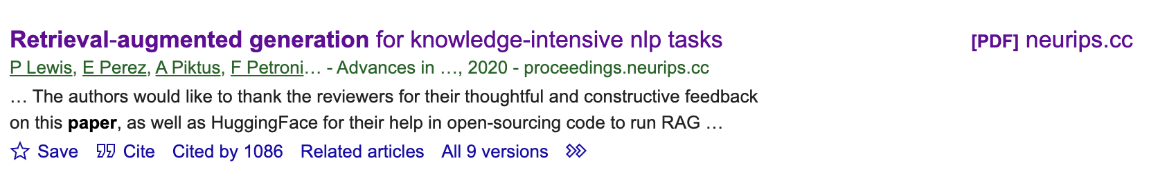
Retrieval-augmented generation
RAG framework: a pre-trained seq2seq model + a dense vector index of Wikipedia (accessed with a pre-trained neural retriever)
The first author Patrick Lewis is from Facebook AI Research.
RAG code in Hugging Face: https://huggingface.co/facebook/rag-token-nq

Slide 8
Q&A

